Slide 1
Social Science Research in the Era of Restricted-Access Data
John M. Abowd Cornell University and U.S. Census Bureau
On the opening of the Federal Statistical Research Data Center in Lincoln, Nebraska April 21, 2016

Slide 2
Acknowledgements
Much of the material in this talk is based on lectures from my Ph.D. course INFO 7470 “Understanding Social and Economic Data,” which was co-developed with Lars Vilhuber under the sponsorship of multiple NSF grants:
https://www.vrdc.cornell.edu/info747x/
This course is available online, without charge, from Cornell University.
A Small Private Online Credit Course (SPOCC) is under development on the EdX platform for release this summer.

Slide 3
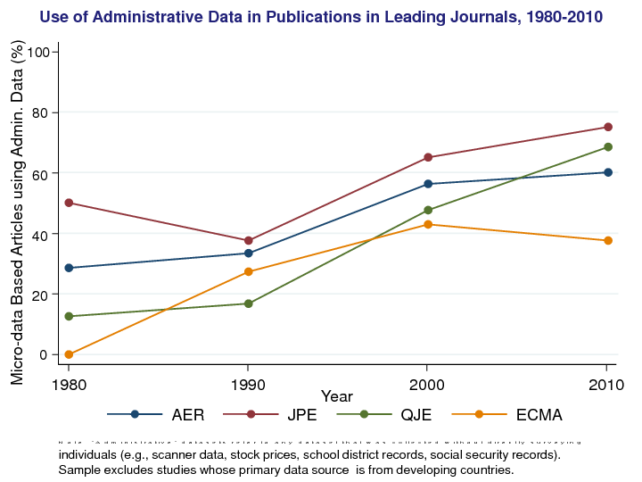
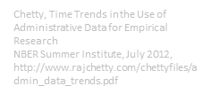

Slide 4
Recent Replication Exercises
Psychology:
Open Science Collaboration (2015) “Estimating the reproducibility of psychological science,” Science 28 Aug 2015: Vol. 349, Issue 6251, DOI: 10.1126/science.aac4716:

Slide 5
OSC (2015) Replication Exercises
(100 studies)
“one-third to one-half of the original findings were also observed in the replication study”

Slide 6
Recent Replication Exercises
Behavioral economics:
Camerer et al. (2016), “Evaluating replicability of laboratory experiments in economics,” Science 03 Mar 2016, DOI: 10.1126/science.aaf0918:

Slide 7
Camerer et al. (2016) Replication Exercises
(18 studies)
“significant effect in the same direction as the original study for 11 replications (61%)”

Slide 8
Verification Is Important
Falsifying data
Andrew Wakefield (autism and vaccines)
Yoshitaka Fujii (fabricated data in 172 out of 249 papers)
“Believe it or not: how much can we rely on published data on potential drug targets?” doi:10.1038/nrd3439-c1 – Drug maker cannot replicate more than 20-25% of findings
“Why Most Published Research Findings Are False” Ioannidis JPA (2005) doi:10.1371/journal.pmed.0020124

Slide 9
But …
Even studies that worry about replication… do not provide their own data in a replicable way “The questionnaire can be obtained from the authors.” (doi:10.1038/nrd3439-c1)

Slide 10
Other Approaches: Replication for a Fee
“The Reproducibility Initiative takes advantage of Science Exchange’s existing network of more than 1,000 core facilities and commercial research organizations. Researchers submit their studies (…) [which] will attempt to replicate the studies for a fee.
Submitting researchers will have to pay for the replication studies (…) one-tenth that of the original study (…) 5 percent transaction fee to Science Exchange.
Participants will remain anonymous unless they choose to publish the replication results in a PLoS ONE Special Collection (source)

Slide 11
Recent Replication Exercises
LDI “reproducibility” project:
Kingi, Stanchi, Vilhuber (2016, unpublished) “The Reproducibility of Economics Research”

Slide 12
Kingi, Stanchi, Vilhuber (2016)
109 articles in American Economic Journal: Applied Economics
Simpler test:
Do the provided data and programs yield the published results?

Slide 13
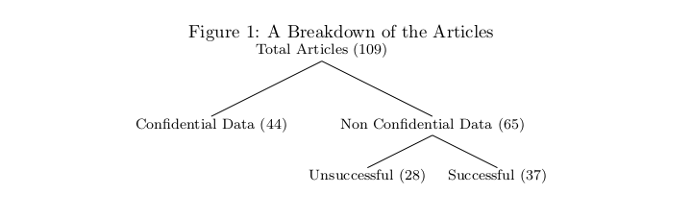
Kingi, Stanchi, Vilhuber (2016)

Slide 14
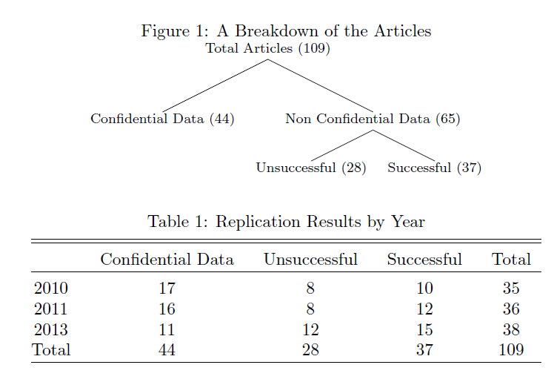
Kinghi, Stanchi and Vilhuber 2016

Slide 15
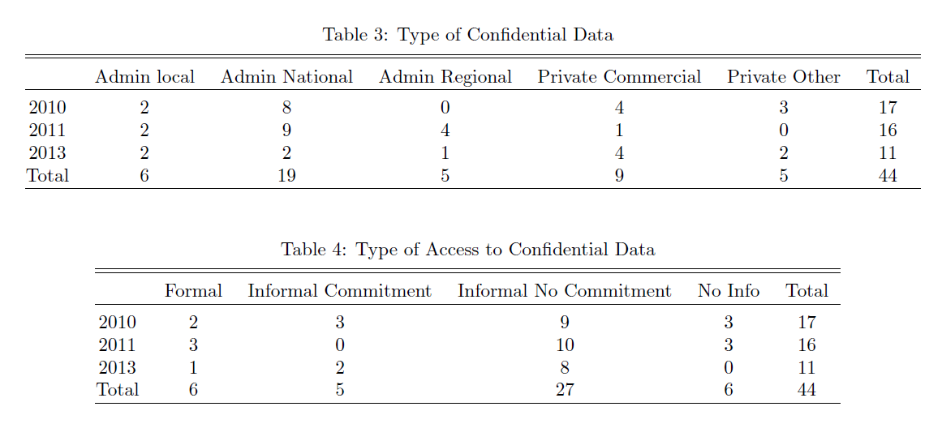

Slide 16
Some Case Studies

Slide 17
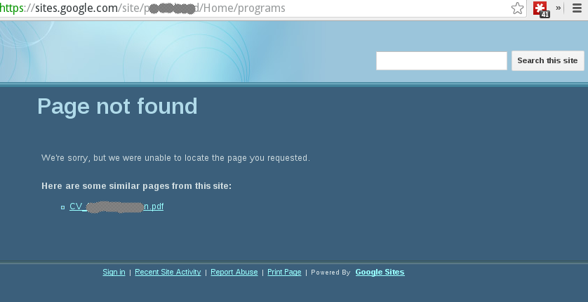
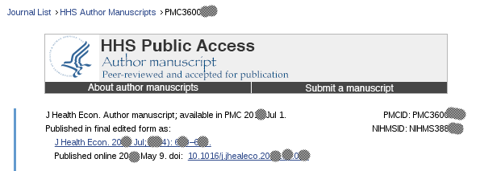

Self-archiving

Slide 18
Or…
“… to respond to the request, I had to turn on the old computer, quickly find the files on the HD, before it overheated and shut down.”

Slide 19
Problems When There Is a Will
Storage on Google, Dropbox, etc. relies on personal payment of recurring cost by researcher
Inadvertent reorganization leads to retrieval failure

Slide 20
Problem when relying on cooperation
“we couldn't replicate the results in Allegretto, Dube, Reich, and Zipperer's (ADRZ) 2013 working paper -- and they wouldn't share their data and code with us”
Source:
Ian Salas’ data archive at https://sites.google.com/site/jmisalas/data-and-code ,
ZIP file at https://drive.google.com/file/d/0B-UoTwKoXafUMlQxajdlRUZ2Vzg/edit,
contains README.txt

Slide 21
A Good Example

Slide 22
Gentzkow, Shapiro, Sinkinson (2014)
Gentzkow, Matthew, Jesse M. Shapiro, and Michael Sinkinson. 2014. "Competition and Ideological Diversity: Historical Evidence from US Newspapers." American Economic Review, 104(10): 3073-3114. DOI: 10.1257/aer.104.10.3073
Data at http://doi.org/10.3886/E1361V3

Slide 23
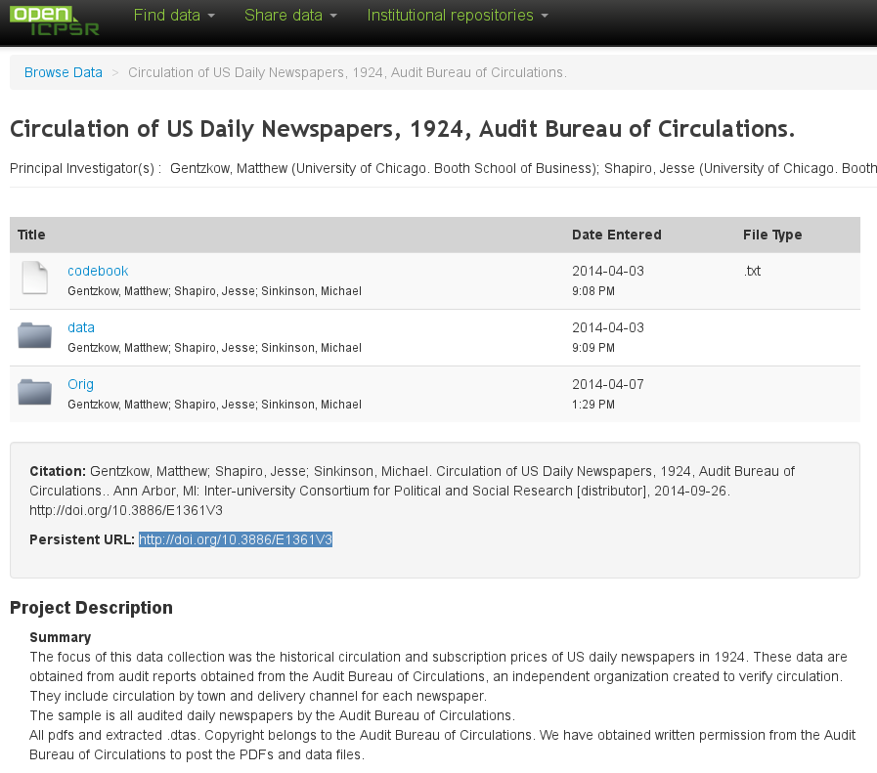

Slide 24
What’s good about this?
Permanent URL
Availability of
Original data
Transformed data
Open availability
Easy online inspection

Slide 25
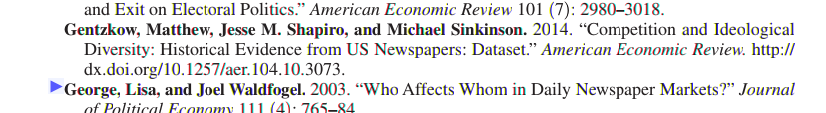
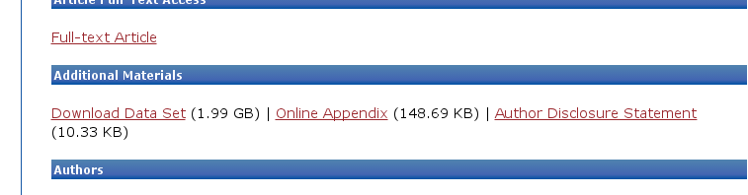
Not Perfect
Archive at openICPSR not actually tied to article and vice-versa
Conversely, “online appendix” just a “blob”

Slide 26
A Self-serving Example

Slide 27
Abowd and Vilhuber (2012)
Article: http://www.aeaweb.org/articles.php?doi=10.1257/aer.102.3.589
Appendix
Description at http://www.aeaweb.org/aer/data/may2012/2012_2790_app.pdf (note: no DOI!)
Tried to be careful about referencing data, but no DOIs available on any of the data
Even our own data (National QWI, 38MB compressed)
Only generic programs
Final dataset was too large – not accepted.

Slide 28
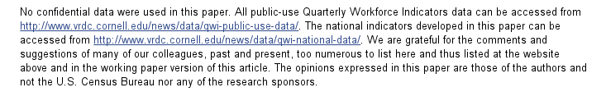
Abowd and Vilhuber (2012)

Slide 29

Abowd and Vilhuber (2012)
No citation of own data

Slide 30
Abowd and Vilhuber (2012)

Slide 31
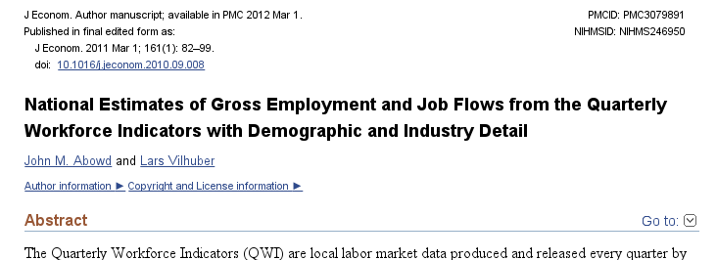
Abowd and Vilhuber (2011)

Slide 32
Abowd and Vilhuber (2011)
Later went back and added a proper replication archive
Done after the fact

Slide 33
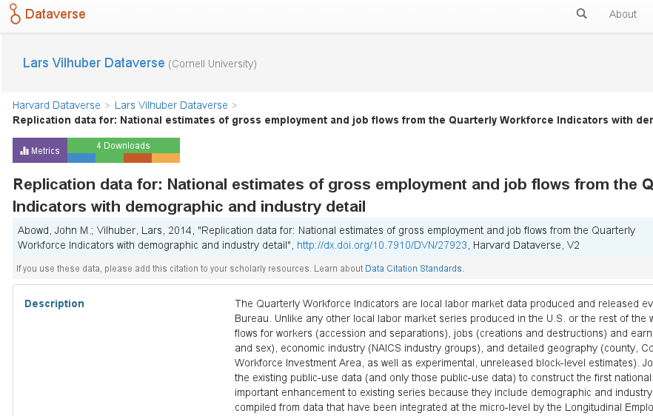
Abowd and Vilhuber (2011)

Slide 34
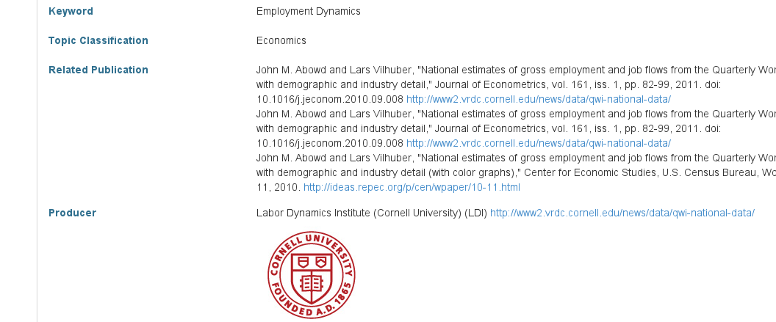
Abowd and Vilhuber (2011)
Replication archive is linked to the article

Slide 35
Abowd and Vilhuber (2011)
But no way to link the article back to the data (post-publication)

Slide 36
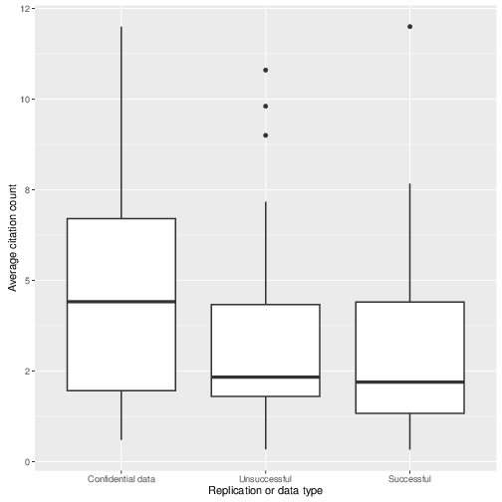
Back to confidential data
Articles using confidential data are (weakly) more cited than others
Data is not available
Metadata is not available
Programs?

Slide 37

Should We Just Trust These Guys?

Slide 38
Core Issues

Slide 39
Core Issues
Insufficient curation (starting with archiving)
No consistent way to learn about the data (metadata)
No way to reference data (unique identifiers)
When there is such an identifier, no culture in citing them
Even when available, no robust way to reproduce (programs)

Slide 40
Replicable Science – A Toolkit

Slide 41
The Goals
Citing data
Facilitating data access
Metadata – discovery of data and its provenance
Better practices in general (programming)

Slide 42
Citing Data

Slide 43
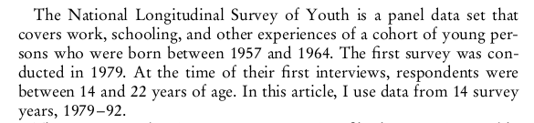
Neal (1999)

Slide 44
Why Do We Cite Data This Way?
Used to be sufficient
Data were the same as a book (see INFO 7470 Session 2)
If not, then they were rarely modified (punch cards, tapes)
Example “NLSY 1979-1992” was a well-defined CDROM – obvious to everybody in… 1993
No longer sufficient
Where is the NLSY CDROM?
Which version does your data library have?

Slide 45
Publications by the Census Bureau
Decennial Census: SF1, SF2, SF3 … once every ten years
Economic Census: Limited number of tables every 5 years
LEHD: 4860 tables every three months

Slide 46
Citing Literature
Why? To prevent plagiarism, to establish provenance of ideas
How? Why do we cite as we do – publishing cycles, uniqueness of sources
Citing literature today: does it still work?
Issues of versioning of articles
Revisions/retractions/corrections

Slide 47
How Do We Cite?
Multiple typographical standards
Generally enough unique keys to correctly identify the source
Current conventions driven to a large extent by the publishing model in effect through the end of the 20th century (see also Margo Anderson’s Session 1 on data publishing)

Slide 48


Examples Based on and using images from http://bcs.bedfordstmartins.com/resdoc5e/RES5e_ch09_s1-0002.html (2013-03-08)

Slide 49
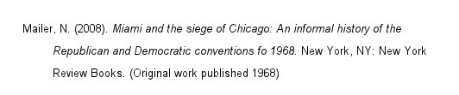
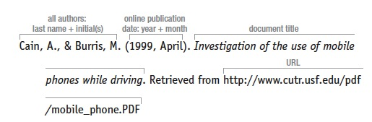
Examples Based on and using images from http://bcs.bedfordstmartins.com/resdoc5e/RES5e_ch09_s1-0002.html (2013-03-08)
Declining uniqueness:
Online documents:

Slide 50
Permanent Links
The URL (Uniform Resource Locator or Web address) may be temporary, may not function in the near or far future
Links designated as “permanent”, “persistent” or “stable” are designed specifically to remain active and useable over time.
Permanent links
Digital Object Identifier (DOIs) (more formally: Handle System)
actionable, interoperable, persistent link
Other Types of Permanent Links
JSTOR (old)
EBSCO
Adapted from http://library.concordia.ca/services/users/faculty/permanentlinks.php

Slide 51
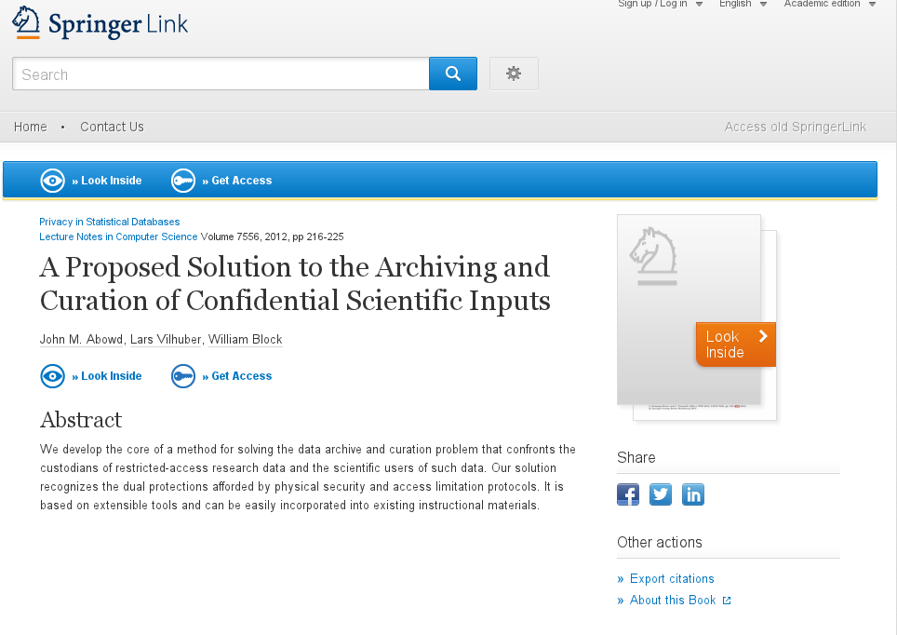
DOI
Notes:
Take for instance one well-known article

Slide 52
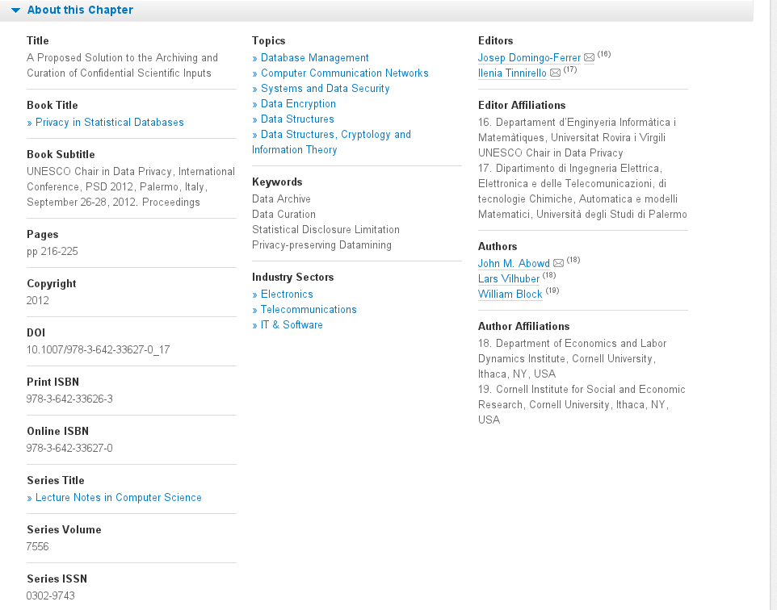
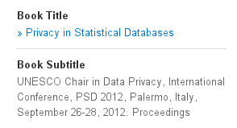


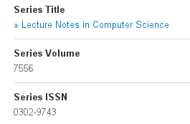
DOI
Notes:
Presence of multiple reference ids: ISBN, ISSN, and new ones: Online ISBN, DOI

Slide 53
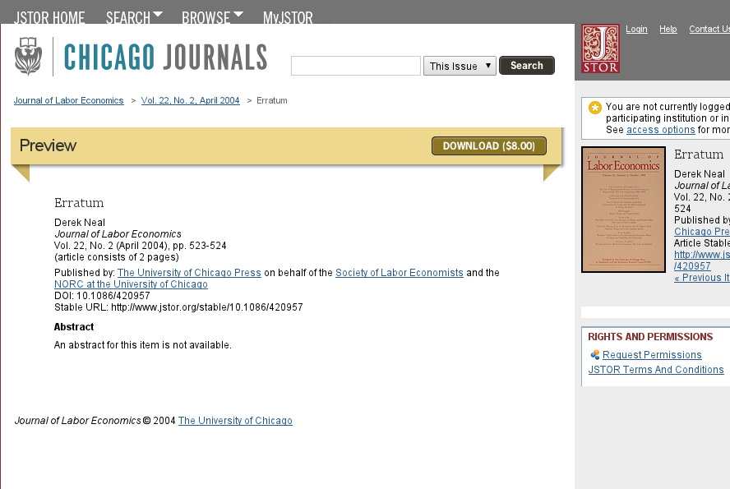

DOI in References

Slide 54
Up to Here …
… nothing new, or mostly
Starting in 5th grade, we’ve been thoroughly trained in citing our “sources”
Or have we?

Slide 55
Improvements

Slide 56
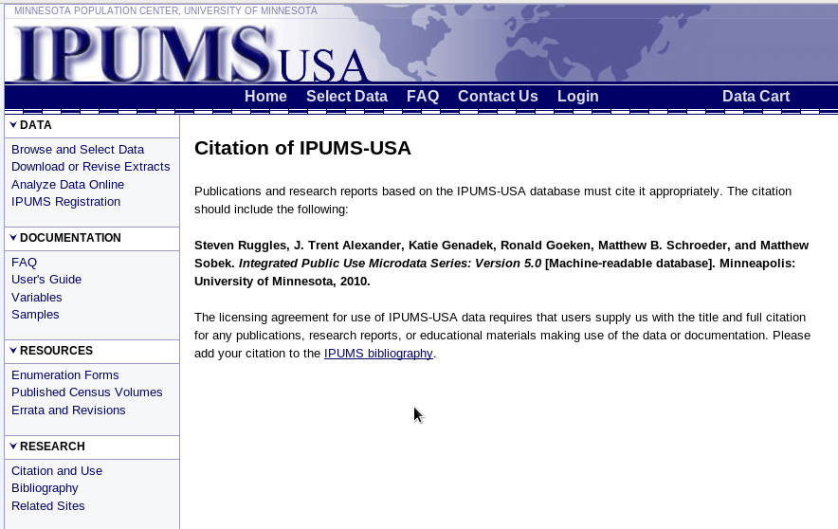
Improvements
https://usa.ipums.org/usa/cite.shtml

Slide 57
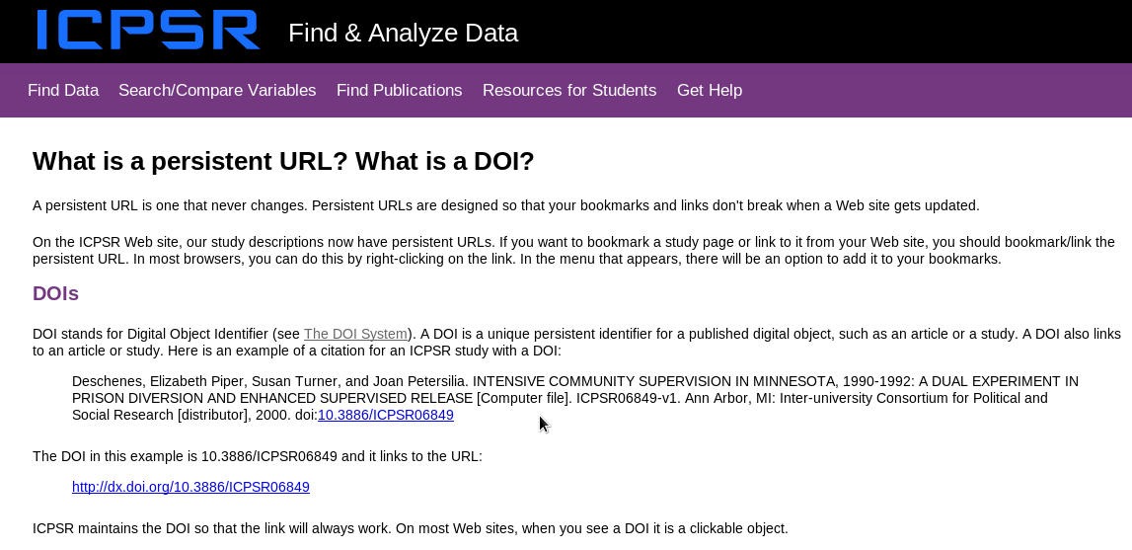
Improvements

Slide 58
These Are the Easy Cases
NLSY, IPUMS-USA, ICPSR data
Public-use datasets or
Data distributor is also data custodian – guarantees availability of the data
Many other public-use datasets
Quarterly Census of Employment and Wages – no (can be defined by latest date on file, but not officially defined)
Quarterly Workforce Indicators – version.txt, but hidden
Business Dynamics Statistics – “yearly” releases (two listed, in fact three)

Slide 59
Data Collected by Researcher
Used to be problematic
Newer methods allow for proper curation (ICPSR, openICPSR, Harvard Dataverse, certain libraries)
See example by Gentzkow, Shapiro, and Sinkinson (2014)
Archival data obtained idiosyncratically
But deposited in an open location, with a clear reference (DOI)

Slide 60
Back to This Issue…
(Chetty, 2012)

Slide 61
How Can We Cite Restricted-use Data?

Slide 62
Citing Restricted-use Data
No current statistical agency has in place a way to uniquely cite data
Black box of restricted-access data enclaves
Worries about “leakage” of confidential information

Slide 63
Citing Restricted-use Data
Abowd, Kramarz, Margolis (1999)
“The data used in this paper are confidential but the authors’ access is not exclusive.”

Slide 64
Citing Restricted-use Data
Schmutte (JOLE, 2015)
“The data used for this paper were prepared in the U.S. Census Bureau’s secure computing facilities as part of an authorized project using the Research Data Center network. The exact analysis files have been fully archived so that the programming sequence submitted in compliance with the JOLE editorial policy can be run in its entirety, except for the component that builds the analysis files from the underlying confidential databases. […]
I am submitting the list of those files, and the last known location of the archive on the Census Bureau’s RDC network as of September 6, 2013 […]”

Slide 65
Not Just in Social Sciences
Nature, 2012 “Many of the emerging ‘big data’ applications come from private sources that are inaccessible to other researchers. The data source may be hidden, compounding problems of veriﬁcation, as well as concerns about the generality of the results.”
Huberman, Nature 482, 308 (16 February 2012), doi:10.1038/482308d

Slide 66
Data Availability Not a New Issue
“In its ﬁrst issue, the editor of Econometrica (1933), Ragnar Frisch, noted the importance of publishing data such that readers could fully explore empirical results. Publication of data, however, was discontinued early in the journal’s history. [...] The journal arrived full-circle in late 2004 when Econometrica adopted one of the more stringent policies on availability of data and programs.”
http://www.econometricsociety.org/submissions.asp#4 as cited in Anderson et al (2005)

Slide 67
Data Access and Provenance Metadata

Slide 68
Core Requirements for Data Access and Provenance Metadata
Royal Society (2012)
Accessible (a researcher can easily find it)
Intelligible (to various audiences)
Assessable (are researchers able make judgments about or assess the quality of the data)
Usable (at minimum, by other scientists)

Slide 69
Identifying Data
“DOI names are assigned to any entity for use on digital networks. They are used to provide current information, including where they (or information about them) can be found on the Internet. Information about a digital object may change over time, including where to find it, but its DOI name will not change.”
http://datacite.org/whatisdoi, accessed on Sept 26, 2012.

Slide 70
Data and Metadata Curation
First step: make (some of) the data accessible
Repositories/data custodians can address the issue for some types of data
Generally provide a way to identify data (DOI)

Slide 71
Repositories
DataOne (bio sciences)
Dryad (ecological data)
DataVerse (data extracts and programs accompanying papers)
University Libraries (Dspace)
UK Data Archive
ICPSR (researcher-initiated surveys)
FRED (St. Louis Fed, time-series)

Slide 72
Journals and Data Curation
PLOS ONE
Policy
Limitations: data limited to 10MB…
AEA
Policy
Example
Econometrica
Policy

Slide 73
PLoS ONE
http://www.plosone.org/static/policies#sharing
“PLOS is committed to ensuring the availability of data and materials that underpin any articles published in PLOS journals.”
“PLOS reserves the right to post corrections on articles, to contact authors' institutions and funders, and in extreme cases to withdraw publication, if restrictions on access to data or materials come to light after publication of a PLOS journal article.”

Slide 74
PLoS ONE (cont.)
“(…)appropriate accession numbers or digital object identifiers (DOIs) published with the paper”
Also guidelines for software (in particular when it is critical to the paper)

Slide 75
AEA Policy
http://www.aeaweb.org/aer/data.php
“Authors of accepted papers that contain empirical work, simulations, or experimental work must provide to the Review, prior to publication, the data, programs, and other details of the computations sufficient to permit replication.”

Slide 76
AEA Policy (cont.)
http://www.aeaweb.org/aer/data.php
For econometric and simulation papers, the minimum requirement should
include the data set(s) and programs used to run the final models
plus a description of how previous intermediate data sets and programs were employed to create the final data set(s)
authors are invited to submit these intermediate data files and programs as an option
[…] as well as instructing a user on how replication can be conducted

Slide 77
Econometrica Policy
http://www.econometricsociety.org/submissionprocedures.asp#replication
“Econometrica has the policy that all empirical, experimental and simulation results must be replicable.
Therefore, authors of accepted papers must submit data sets, programs, and information on empirical analysis, experiments and simulations that are needed for replication and some limited sensitivity analysis”
Limited-access/proprietary datasets: “detailed data description and the programs used to generate the estimation data sets must be provided, as well as information of the source of the data so that researchers who do obtain access may be able to replicate the results”

Slide 78
Limitation of Current Repositories
Do not (yet) provide full provenance
For lack of citation tools
For lack of guidance
Limitations when using “big data”
Repository not the solution (suggested size: <10MB, but more recent publications have data appendices in the single-digit GB range)
Unique references to data publication, onus on publisher?
Do not work (well) for restricted-access data

Slide 79
Well…
Can we at least make information available such that these two goals can be met:
Intelligible (to various audiences);
Assessable (are researchers able make judgments about or assess the quality of the data);

Slide 80
Metadata Access
Information about the data
Can be
Variable names
Formats
Values
Distribution of values
Description
Provenance

Slide 81
Metadata on Public-use Data
IPUMS: Structured/browseable metadata
Most other sites:
PDF or ASCII files
Generally not linked to actual data
Restricted-access data in Census RDC
Generic information outside
PDF once access granted

Slide 82
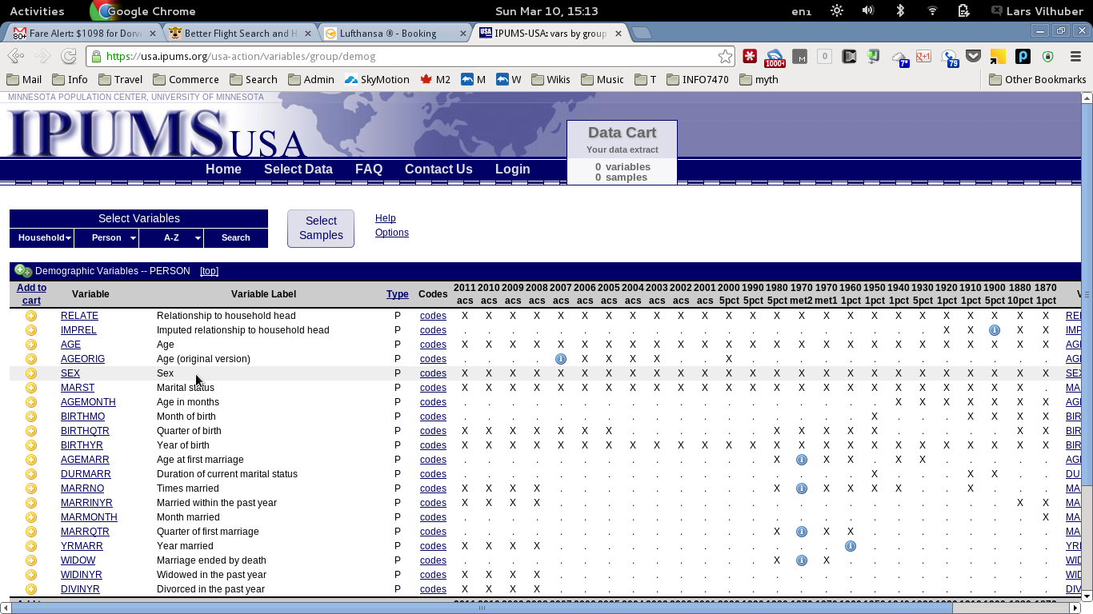
IPUMS Metadata

Slide 83
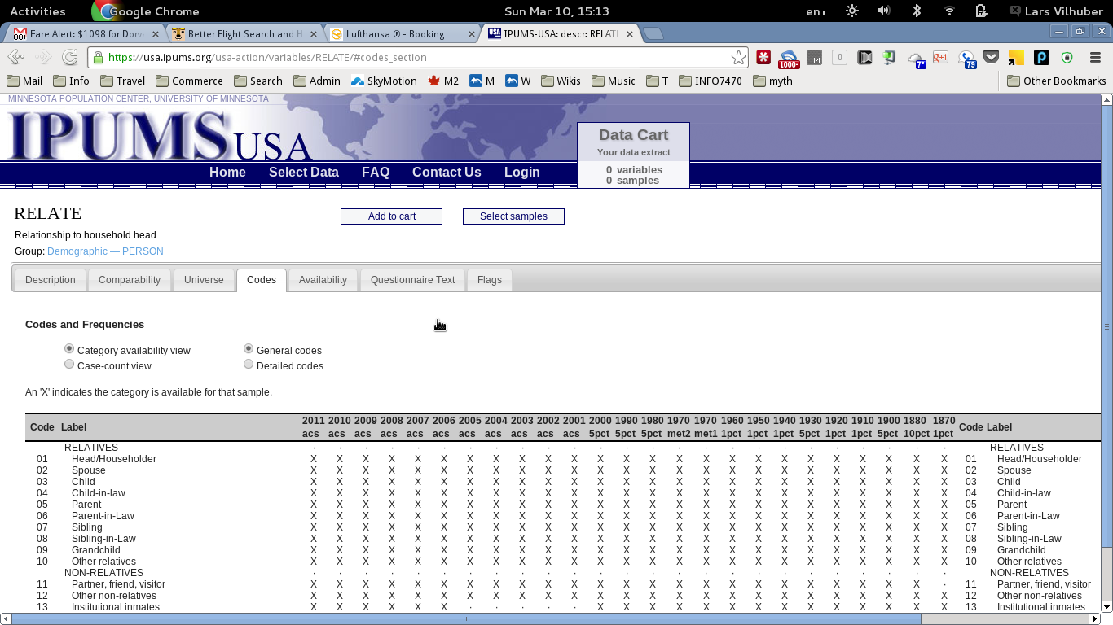
IPUMS Metadata (Details)

Slide 84
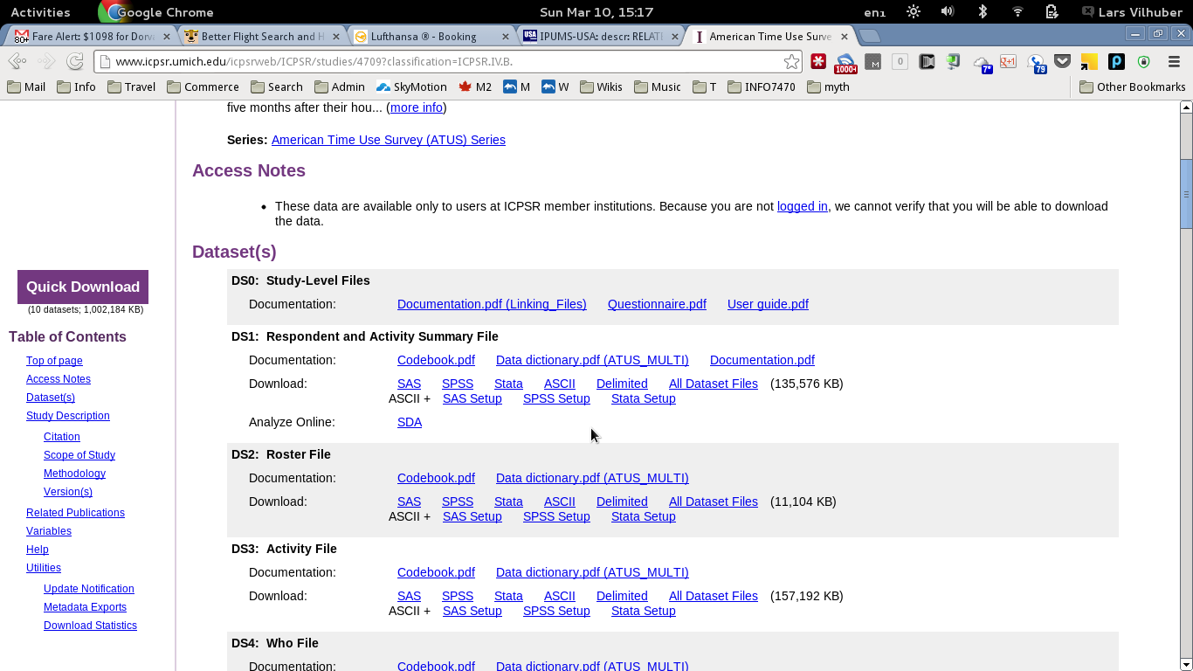
ICPSR Metadata on ATUS

Slide 85
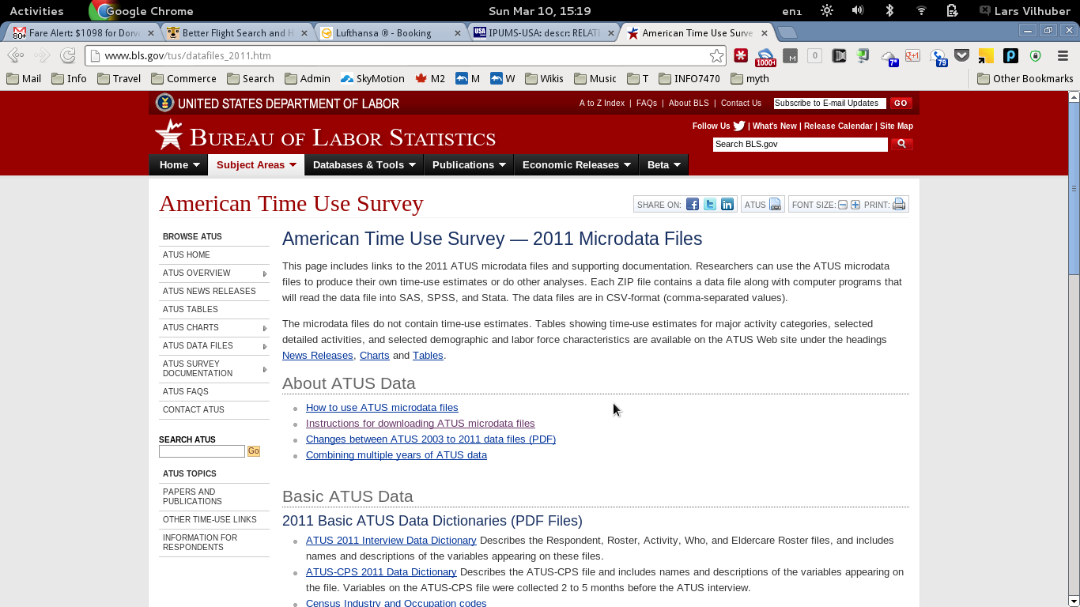
BLS Metadata on ATUS

Slide 86
Current Metadata on Confidential Data
Mostly by inference
Census Bureau (CES):
links to public-use tabulations, documents (some by yours truly), codebooks (Snapshot S2004)
PDFs of detailed data in RDC
Codebooks for a few data sets at ICPSR
1960 (ICPSR 21980); 1970 (21981); 1980 (21982); 1990 (21983); 2000 (21820)
NCHS:
what is in questionnaire (PDF) but not in public-use codebook (PDF) might be accessible

Slide 87
Approaches and Solutions
NCRN-Cornell node: Comprehensive Extensible Data Documentation and Access Repository (CED²AR) http://www.ncrn.cornell.edu/ced2ar/
Based on existing metadata standards (DDI) with possible extensions
Provide structured mechanism to synchronize confidential and public-use metadata
Assign DOI where needed

Slide 88
Programming

Slide 89
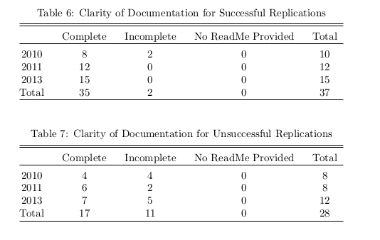
Programming
You’ve found the data
You’ve found the programs
The programs actually run cleanly

Slide 90
What Do the Programs Do?

Slide 91
Not Quite Literate Programming
Literate programming: “a program is given as an explanation of the program logic in a natural language, such as English, interspersed with snippets of macros and traditional source code, from which a compilable source code can be generated”
Source: Knuth, Donald E. (1984). "Literate Programming" (PDF). The Computer Journal (British Computer Society) 27 (2): 97–111. doi:10.1093/comjnl/27.2.97 (via Wikipedia)

Slide 92
Terms You May Encounter
Weave (created legible text) and tangle (create executable program)
May encounter these with R (Sweave – core R documentation tool), Python (tons of packages)
Related: replicable documents (R Markdown, StatRep for SAS)

Slide 93
Simpler: Legible Programming
Have clear sequences of programs
Have clear programing style
Have clear comments

Slide 94
Structuring Programs
mystuff.sas:
1 data ”C:\Users\Me\CensusChina.sas7bdat” ;
2 set ”C:\ Users\Me\CensusChina.sas7bdat” ;
3 earn=log(earn) ;
4 run ;
5 proc reg data = ”C:\Users\Me\CensusChina.sas7bdat” ;
6 model earn = sex education experience ;
7 run ;
What can possibly be wrong about that?

Slide 95
OK, Most Economists Use Stata

Slide 96
Structuring Programs
mystuff.do :
use "C:\Users\Me\CensusChina.dta"
replace earn=log(earn)
regress earn sex education experience
save, replace
What can possibly be wrong about that?

Slide 97
Everything!
Name of program: uninformative
Destruction of original data: program cannot be re-run for same results
No portability: cannot be run anywhere else
No explanation: why are we doing this?

Slide 98
Think of Yourself as Highly Amnesiac...
The research paper you are writing now will be submitted, rejected, worked on, questioned...
... by others and yourself
... in intervals of weeks, months, years...
Your future research assistant and the future YOU will need to understand how to go through it

Slide 99
Naming

Slide 100
Naming Programs Is Not Innocuous
Really bad
mystuff.R
read.R
version2.R
ols.sas
OK
readCensus.R
readBLS.R
prepareCensus.R
runOLS.sas

Slide 101
Naming Programs
Suggested
01_readBLS.R
02_readCensus.R
03_prepareCensus.R
04_create_analysis_data.R
05_runOLS.sas

Slide 102
Improving Programs
mystuff.do :
// Define locations
local INPUT “c:/users/me/”
local OUTPUT “c:/users/paper2016-1/data/$S_DATE”
local RESULTS “c:/users/paper2016-1/results/$S_DATE”
// We create the output and results directory for today’s run
mkdir `OUTPUT’
mkdir `RESULTS’
log using “`RESULTS’/chinaregression.log”, append
// We already have the data, we downloaded it from
// chinastats.gov.cn on Feb 29, 2015
// Checksum: b61d5c8eb841c28fb62126e782ba0b0e
use “`INPUT’/CensusChina.dta“, clear
// We need log earnings
gen logearn=log(earn)
save “`OUTPUTS’/analysis_china”, replace
// We estimate the classical mincer regression for starters
regress logearn sex education experience
exit, clear

Slide 103
Why Do We Emphasize This Now?
Portability of programs
You move the analysis to a compute cluster running Linux
Your next computer is running SuperOS 15.0
Legibility of code
While not ideal, at least some reference to where data comes from
Separation of input and output data
Logging of results in an automatic (=failsafe) way

Slide 104
Considerations
What happens if the data preparation stage takes days, but the analysis minutes?
What happens when you need to repeat the analysis 500 times, but the data preparation stays the same?
Suppose I wanted to redo the analysis for other universes?

